Slide 1

Chapter 2: A Simple Compiler
陳奇業 成功大學資訊工程系

Slide 2
Outlines
2.1 An Informal Definition of the ac Language
2.2 Formal Definition of ac
2.3 Phases of a Simple Compiler
2.4 Scanning
2.5 Parsing
2.6 Abstract Syntax Trees
2.7 Semantic Analysis
2.8 Code Generation

Slide 3
Source
Program
Scanner
Tokens
Parser
Syntactic
Semantic
Routines
(Character
Stream)
Structure
Intermediate
Representation
Symbol and
Attribute
Tables
Optimizer
(Used by all
Phases of
The Compiler)
Code
Generator
The structure of a Syntax-Directed Compiler
Target Machine
Code

Slide 5
An Informal Definition of the ac Language
Types: There are only two data types: integer and float. An integer type is a sequence of decimal numerals, as found in most programming languages. A float type allows five fractional digits after the decimal point.
Keywords: There are three reserved keywords, each limited for simplicity to a single letter: f (declares a float variable), i (declares an integer variable), and p (prints the value of a variable).
Variables: The ac language offers only 23 possible variable names, drawn from the lowercase Roman alphabet and excluding the three reserved keywords f, i, and p. Variables must be declared prior to using them.

Slide 6
An Informal Definition of the ac Language
In some cases, such type conversion is handled automatically by the compiler, while other cases require explicit syntax (such as casts) to allow the type conversion.
In ac, conversion from integer type to float type is accomplished automatically. Conversion in the other direction is not allowed under any circumstances.

Slide 7
An Informal Definition of the ac Language
For the target of translation, we use the widely available program dc (for desk calculator), which is a stack-based calculator that uses reverse Polish notation (RPN逆波蘭表示法).
When an ac program is translated into a dc program, the resulting instructions must be acceptable to the dc program and must faithfully represent the operations specified in an ac program.

Slide 8
Formal Definition of ac
Before translating ac to dc we must first understand the syntax and semantics of the ac language.
We use a context-free grammar (CFG) to specify our language’s syntax and regular expressions to specify the basic symbols of the language.

Slide 9
The Syntax of ac
Ac’s syntax is defined by a context-free grammar (CFG)
CFG is also called BNF (Backus-Naur Form 巴科斯範式) grammar
CFG consists of a set of production rules,
A→B C D… Z
LHS must be a single nonterminal
RHS consists 0 or more terminals or nonterminals
LHS
RHS

Slide 10
Syntax Specification

Slide 13
Token Specification

Slide 14
An ac Scanner
The ac Scanner will be a function of no arguments that returns token values
There are 10 tokens.
typedef enum token_types {
floatdcl, intdcl, print, id, assign, plus,
minus, inum, fnum, blank
} token;
Extern token scanner(void);

Slide 15
An ac Scanner (Cont’d)
The scanner returns the longest string that constitutes a token, e.g., in
abcdef
ab, abc, abcdef are all valid tokens.
The scanner will return the
longest one (i.e., abcdef).

Slide 16
Phases of a Simple Compiler
The scanner reads a source ac program as a text file and produces a stream of tokens.
The parser processes tokens produced by the scanner, determines the syntactic validity of the token stream, and creates an abstract syntax tree (AST) suitable for the compiler’s subsequent activities.
The AST created by the parsing task is next traversed to create a symbol table. This table associates type and other contextual information with variables used in an ac program.
The AST is next traversed to perform semantic analysis.
Finally, the AST is traversed to generate a translation of the original program.

Slide 17
Scanning
The scanner’s job is to translate a stream of characters into a stream of tokens, where each token represents an instance of some terminal symbol.
Each token found by the scanner has the following two components: 1. A token’s type explains the token’s membership in the terminal alphabet. All instances of a given terminal have the same token type. 2. A token’s semantic value provides additional information about the token. For terminals such as plus, no semantic information is required, because only one token (+) can correspond to that terminal. Other terminals, such as id and num, require semantic information so that the compiler can record which identifier or number has been scanned.

Slide 18
Scanning
For most programming languages, the scanner’s job is not so easy. Some tokens (+) can be prefixes of other tokens (++); other tokens such as comments and string constants have special symbols involved in their recognition.

Slide 19
Scanner for the ac language.

Slide 20
Finding inum or fnum tokens for the ac language

Slide 21
Parsing
The parser is responsible for determining if the stream of tokens provided by the scanner conforms to the language’s grammar specification.
We build a parser for ac using a well-known parsing technique called recursive descent.

Slide 22
Ambiguity (模稜兩可）
Suppose we used a single nonterminal string and did not distinguish between digits and lists. We could have written the grammar string → string + string | string - string | 0 | 1 | 2 | 3 | 4 | 5 | 6 | 7 | 8 | 9

Slide 23
Associativity of Operators
By convention, 9+5+2 is equivalent to (9+5)+2 and 9-5-2 is equivalent to (9-5)-2. When an operand like 5 has operators to its left and right, conventions are needed for deciding which operator applies to that operand. We say that the operator + associates to the left, because an operand with plus signs on both sides of it belongs to the operator to its left.
Some common operators such as exponentiation are right-associative. As another example, the assignment operator = in C and its descendants is right associative; that is, the expression a=b=c is treated in the same way as the expression a= (b=c) .

Slide 24
Associativity of Operators
Left recursion => left-associative
Right recursion => right-associative
Strings like a=b=c with a right-associative operator are generated by the following grammar: right → letter = right | letter letter → a | b | … | z

Slide 25
Precedence of Operators
Consider the expression 9+5*2. There are two possible interpretations of this expression: (9+5) *2 or 9+ (5*2).
Ex. : A grammar for arithmetic expressions can be constructed from a table showing the associativity and precedence of operators. expr → expr + term | expr - term | term term → term * factor I term / factor | factor factor → digit | ( expr )

Slide 26
Parse Tree Construction
Most parsing methods fall into one of two classes, called the top-down and bottom-up methods.
In top-down parsers, construction starts at the root and proceeds towards the leaves, while in bottom-up parsers, construction starts at the leaves and proceeds towards the root.

Slide 27

Top-Down Parsing
stmt → expr ; | if ( expr ) stmt | for ( optexpr ; optexpr ; optexpr ) stmt | other
optexpr →$ε$ | expr

Slide 28
Predicting a Parsing Procedure
Each procedure first examines the next input token to predict which production should be applied. For example, Stmt offers two productions:
Stmt→id assign Val Expr
Stmt→print id

Slide 29
Recursive-descent Parsing
Recursive-descent parsing is a top-down method of syntax analysis in which a set of recursive procedures is used to process the input.
FIRST(stmt) = {expr, if, for, other}

Slide 30
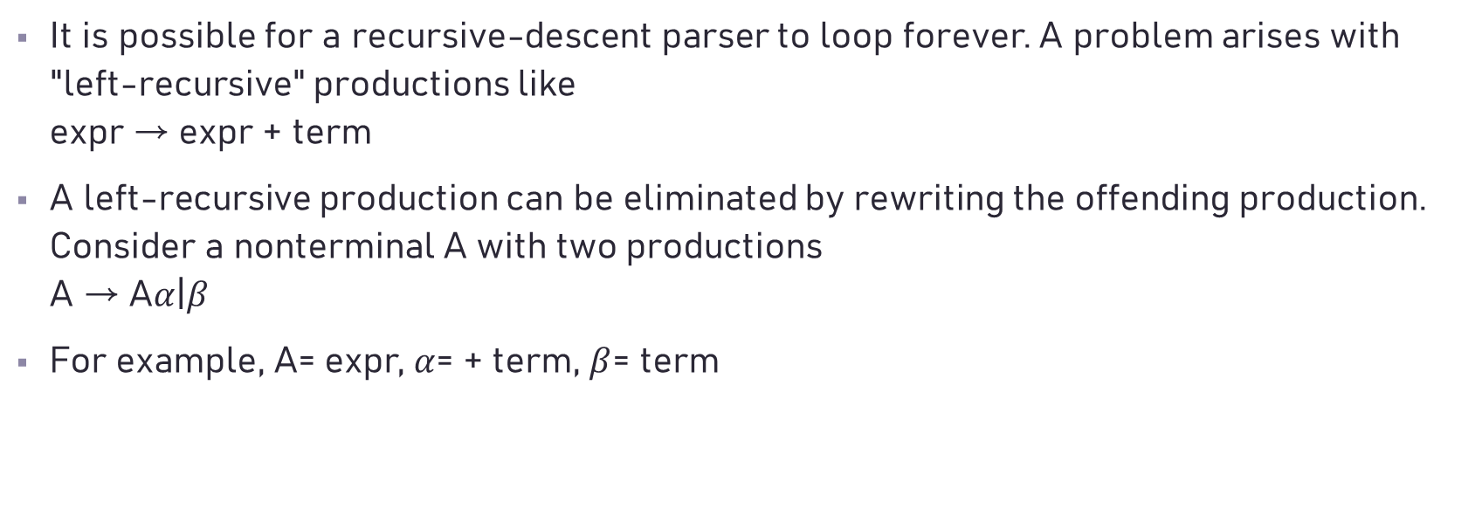
Left Recursion
It is possible for a recursive-descent parser to loop forever. A problem arises with "left-recursive" productions like expr → expr + term
A left-recursive production can be eliminated by rewriting the offending production. Consider a nonterminal A with two productions A → A$α$|$β$
For example, A= expr, $α$= + term, $β$= term

Slide 31

Left Recursion
We can convert left recursion to right recursion in the following manner, using a new nonterminal R: A →$β$R R → $α$R|$ϵ$

Slide 32
Abstract Syntax Trees
While the process of compilation begins with scanning and parsing, following are some aspects of compilation that can be difficult or even impossible to perform during syntax analysis:
Most programming language specifications include prose that describes aspects of the language that cannot be specified in a CFG. Ex: x.y.z in Java, operator overloading.
For relatively simple languages, syntax-directed translation can perform almost all aspects of program translation during syntax analysis. However, from a software engineering perspective, the separation of activities and concerns into phases (such as syntax analysis, semantic analysis, optimization, and code generation) makes the resulting compiler much easier to write and maintain.
In response to the above concerns, we might consider using the parse tree as the structure that survives syntax analysis and is used for the remaining phases.

Slide 33
Abstract Syntax Trees
However, such trees can be rather large and unnecessarily detailed, even for very simple grammars and inputs.
It is therefore common practice to create an artifact of syntax analysis known as the abstract syntax tree (AST). This structure contains the essential information from a parse tree, but inessential punctuation and delimiters (braces, semicolons, parentheses, etc.) are not included.

Slide 34
Parse Tree
Abstract Syntax Tree

Slide 35
Syntax-Directed Translation
Two concepts related to syntax-directed translation:
Attributes. An attribute is any quantity associated with a programming construct. Examples of attributes are data types of expressions, the number of instructions in the generated code, or the location of the first instruction in the generated code for a construct …
Translation schemes. A translation scheme is a notation for attaching program fragments to the productions of a grammar. The program fragments are executed when the production is used during syntax analysis. The combined result of all these fragment executions, in the order induced by the syntax analysis, produces the translation of the program to which this analysis/synthesis process is applied.

Slide 36
Synthesized Attributes

Slide 37
Tree Traversals
Tree traversals will be used for describing attribute evaluation and for specifying the execution of code fragments in a translation scheme.
depth-first traversal

Slide 38
Translation Schemes
A syntax-directed translation scheme is a notation for specifying a translation by attaching program fragments to productions in a grammar.
The position at which an action is to be executed is shown by enclosing it between curly braces and writing it within the production body, as in rest → + term {print('+’)} rest₁

Slide 39
Translation Schemes
expr → expr₁ + term {print('+’)}
expr → expr₁ - term {print('-’)}
expr → term
term → 0 {print (‘0’)}
term → 1 {print (' 1’)}
...
term → 9 {print ('9’)}

Slide 40
Translation Schemes
Let
Then the left-recursion-eliminating transformation produces the translation scheme

Slide 41
Translation Schemes

Slide 42
Semantic Analysis
For the ac language, we focus on two aspects of semantic analysis: symbol table construction and type checking.

Slide 43
Type Checking

Slide 44
AST after semantic analysis

Slide 45
Code Generation

Slide 46
Code Generation

